Slide 1
ProfileBook – Social Media Web Application
By
Shaik vaseem

Slide 2

Problem Statement
Social media platforms often lack proper moderation and approval systems.
There is a need for a platform where posts are verified and user interactions are secure.

Slide 3
What I Did
Designed and developed ProfileBook using Angular (Frontend) & ASP.NET Core MVC (Backend).
Implemented features like authentication, posting, messaging, reporting, and admin moderation.

Slide 4
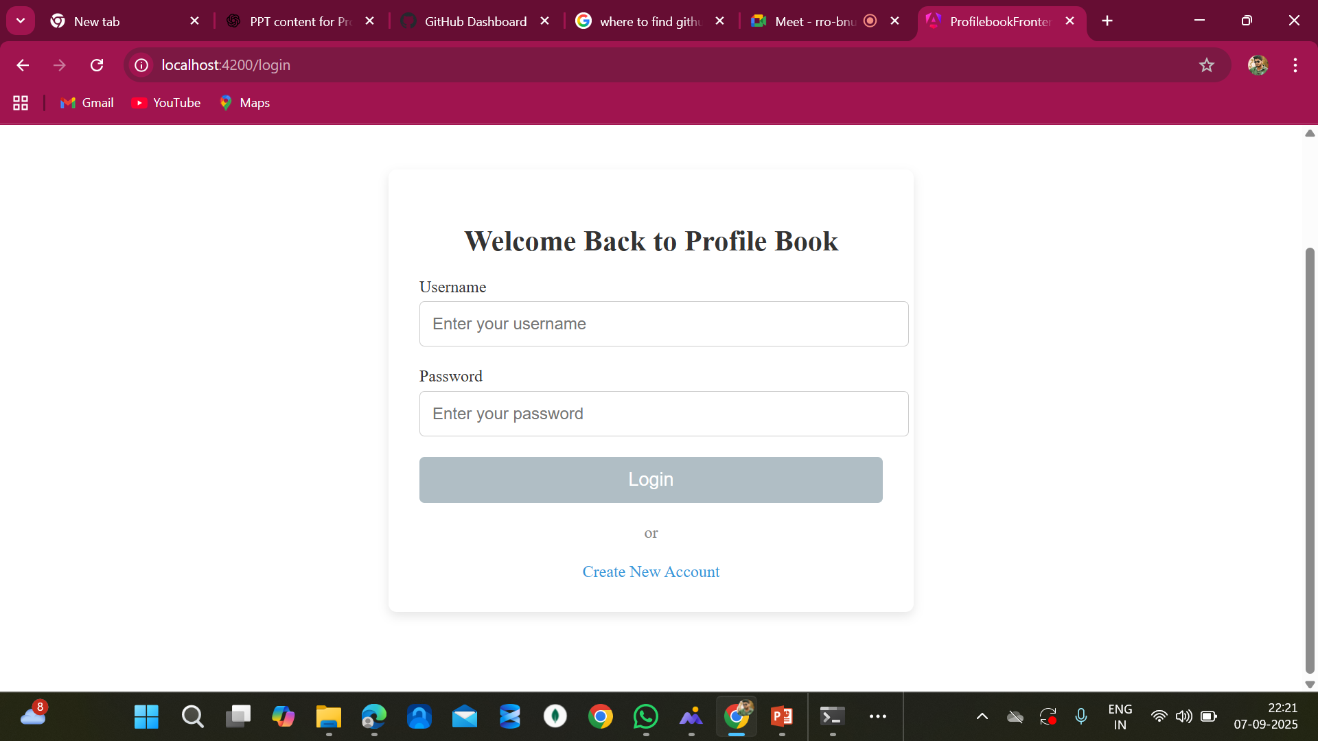
Login Page
A secure login page common for both users and admins.
Supports authentication using username & password with account creation option.

Slide 5
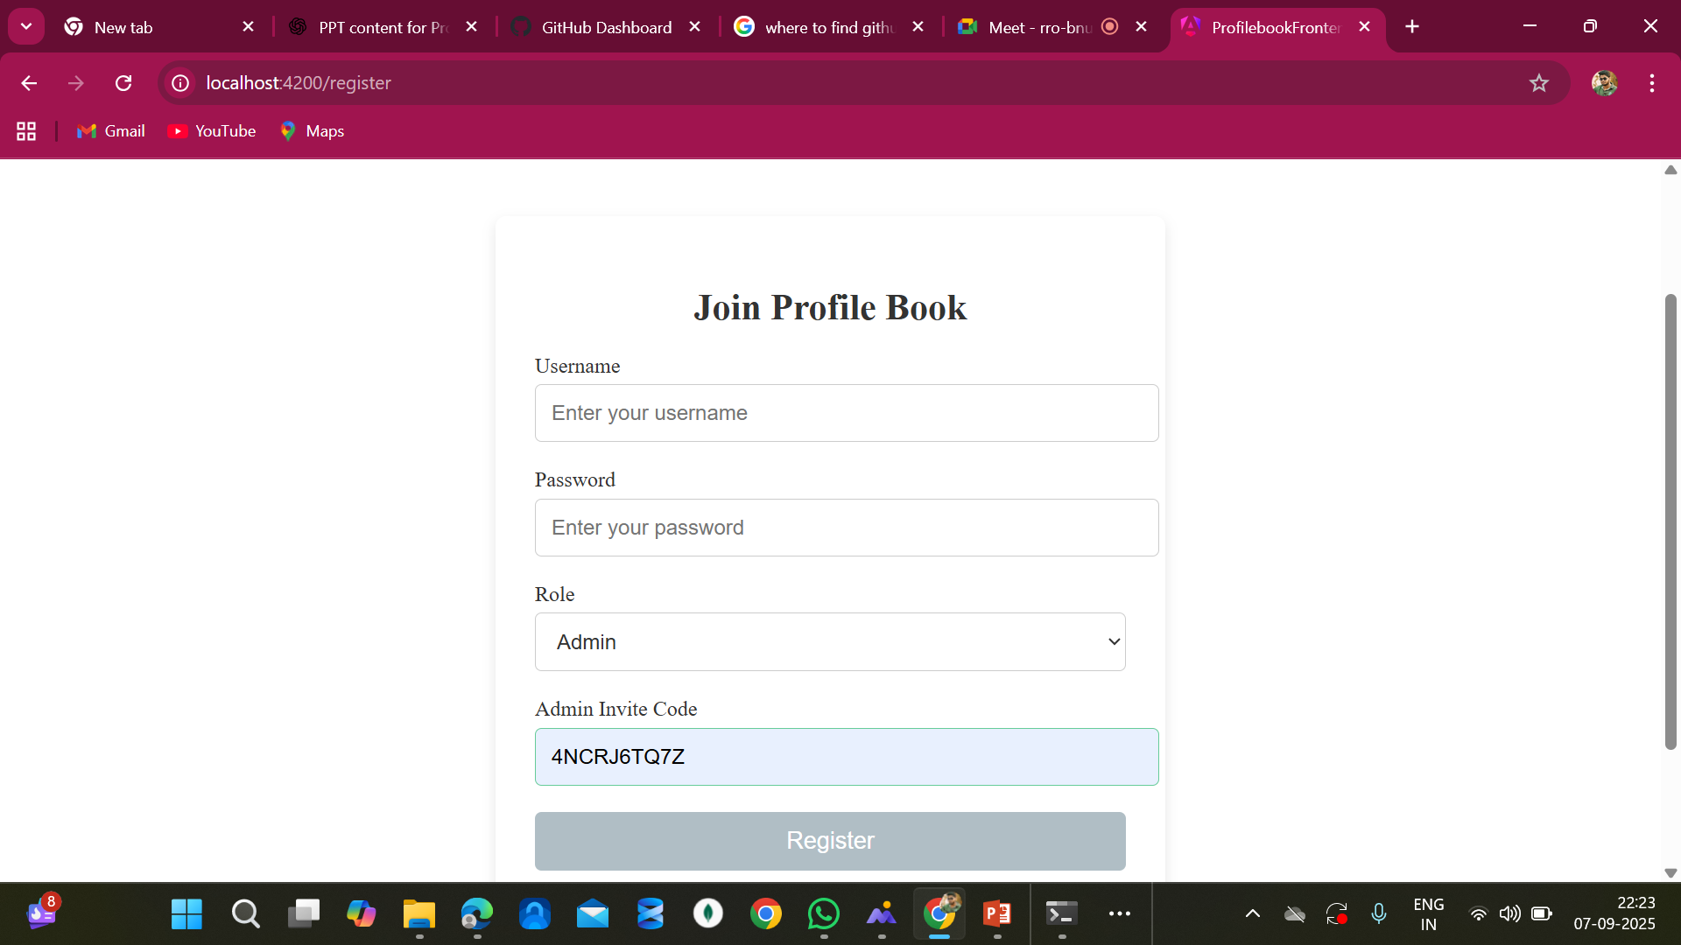
Admin Register Page
Dedicated registration form for both users and admins.
Admins require a unique invite code for secure access.

Slide 6
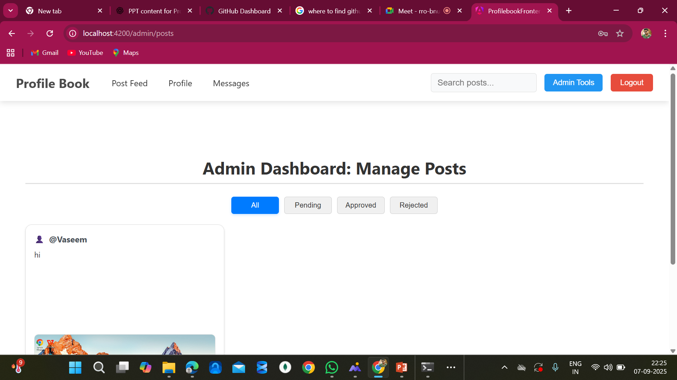
Admin Dashboard
Admins can review, approve, or reject posts submitted by users.
Provides clear tabs for managing posts: All, Pending, Approved, Rejected.

Slide 7
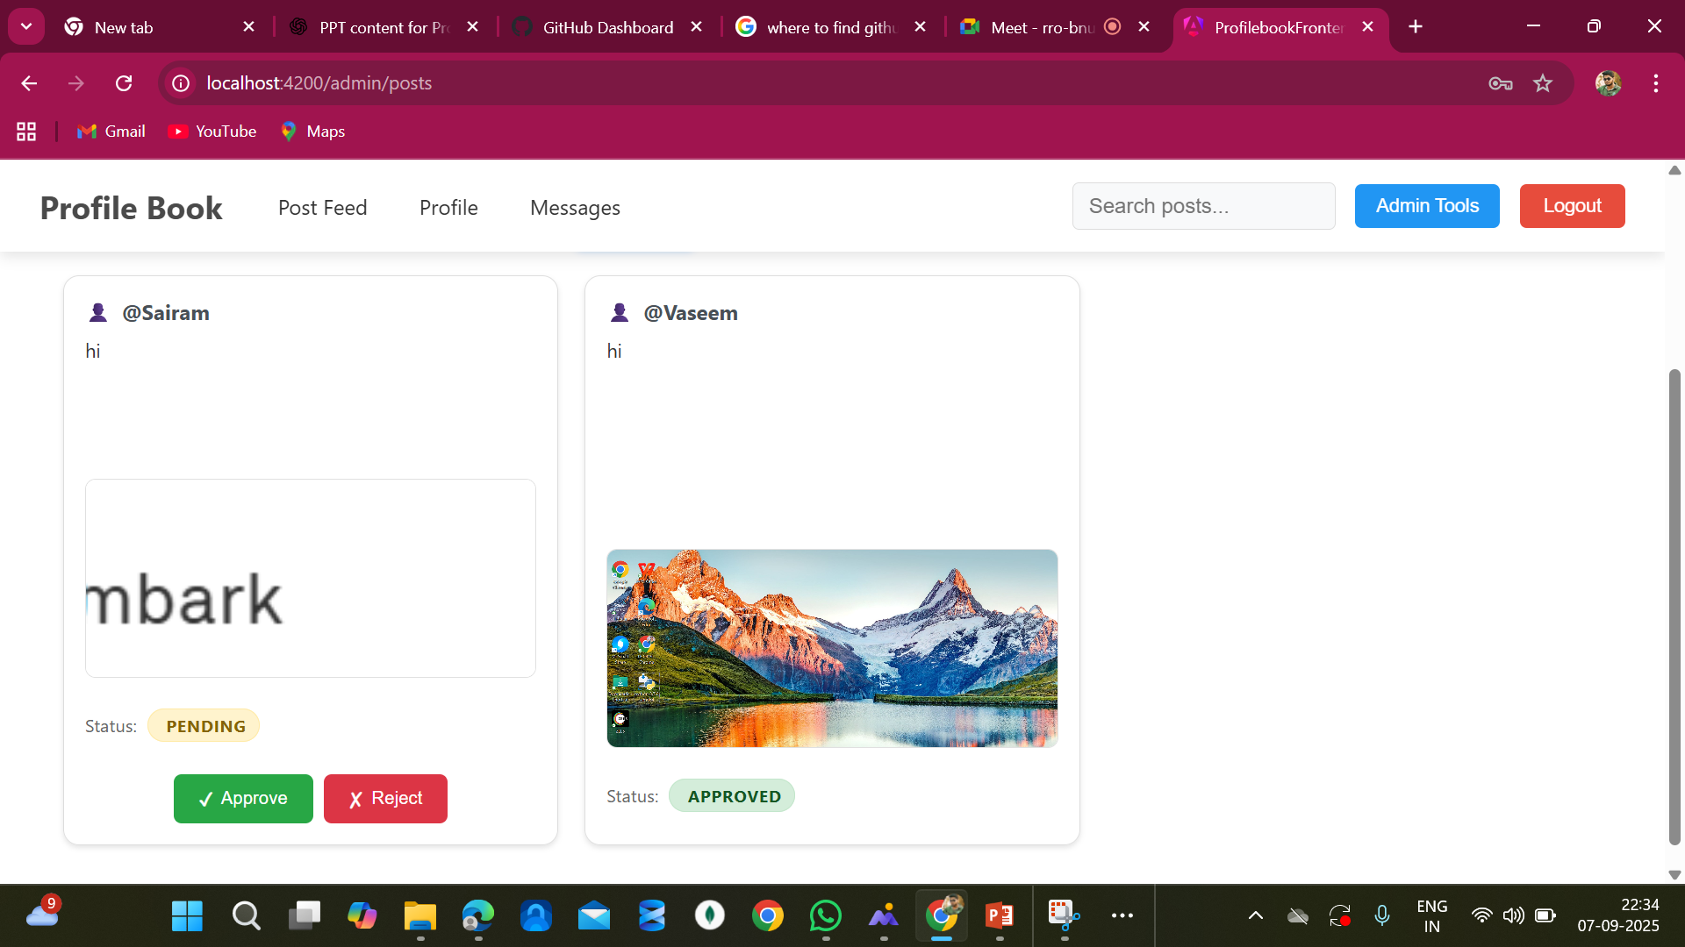
Admin Manage Posts
Admin can view pending and approved posts in one place.
Provides quick Approve/Reject actions to ensure content moderation.

Slide 8
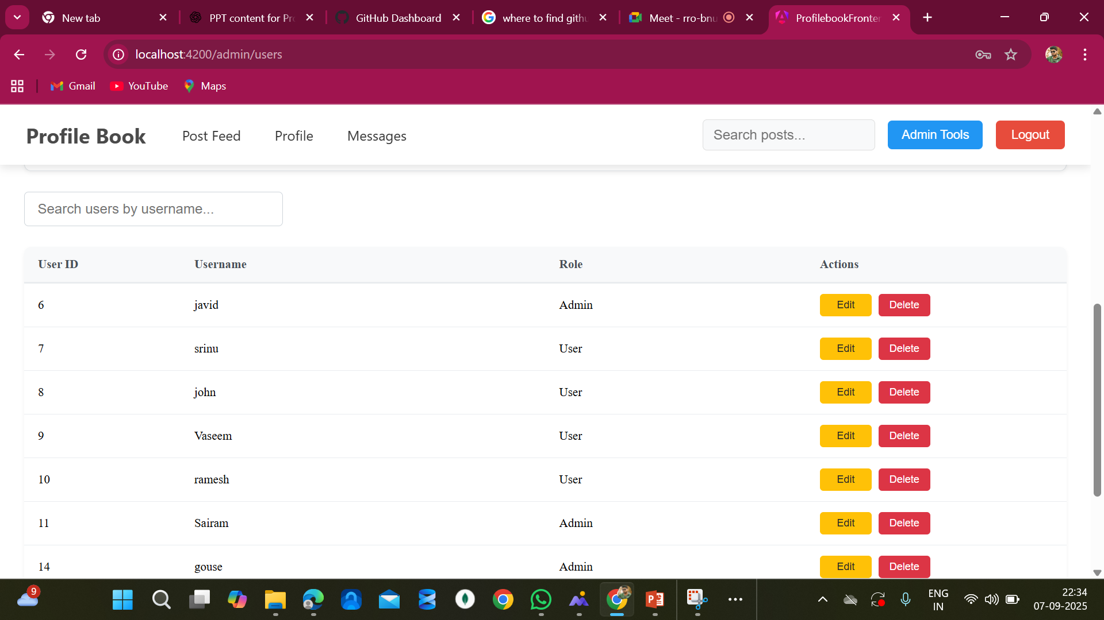
Admin Manage user

Slide 9
Admin manage Posts

Slide 10
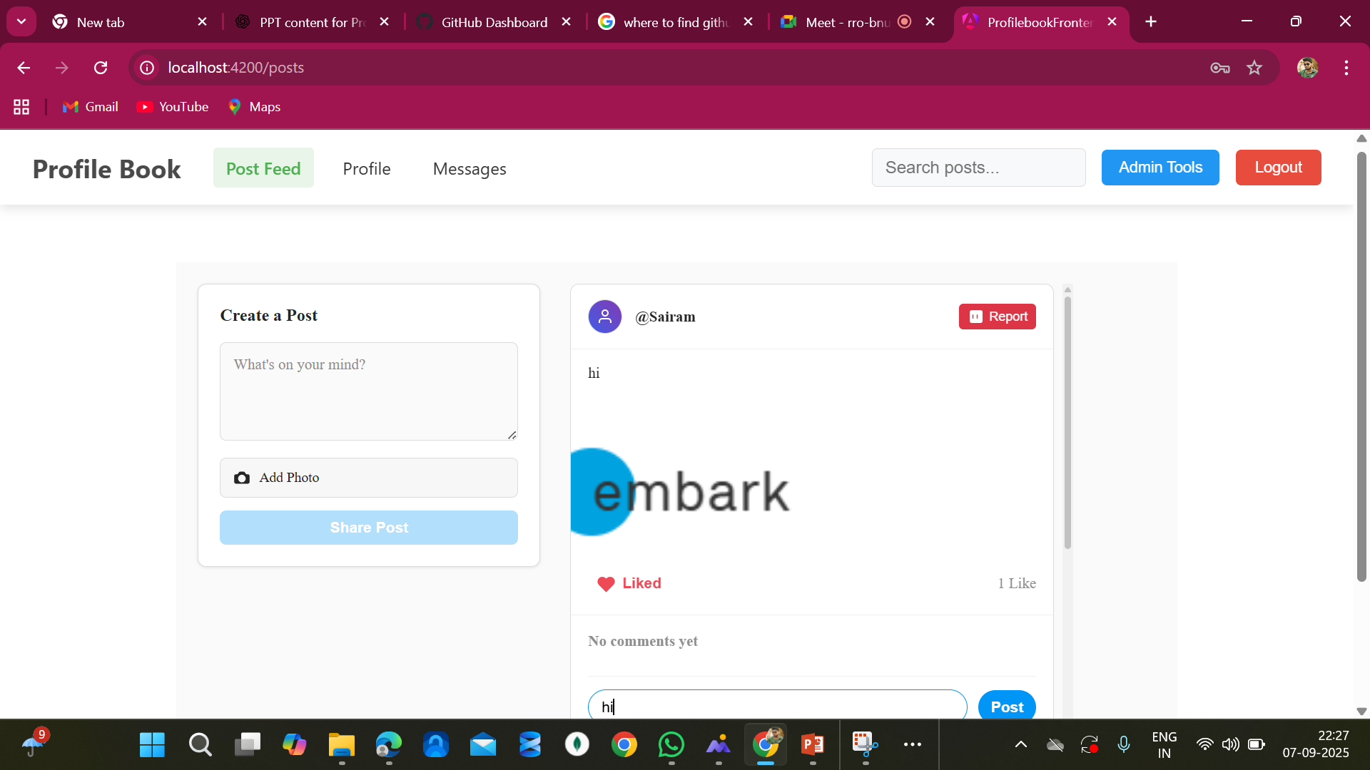
comments

Slide 11
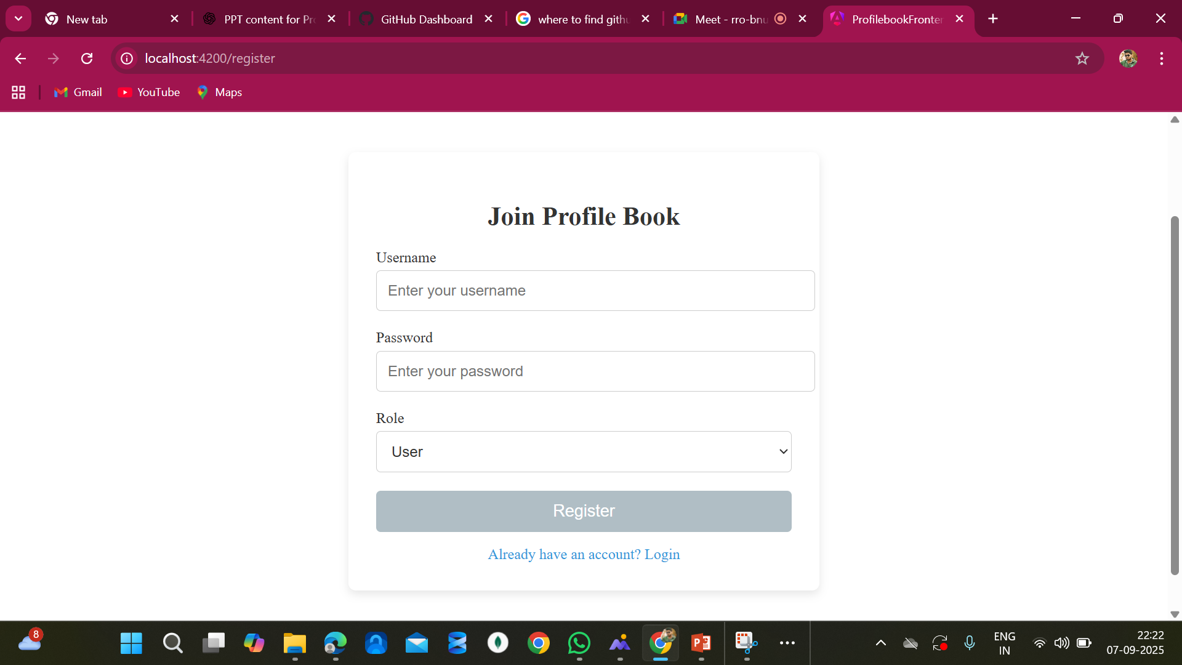
User Register

Slide 12
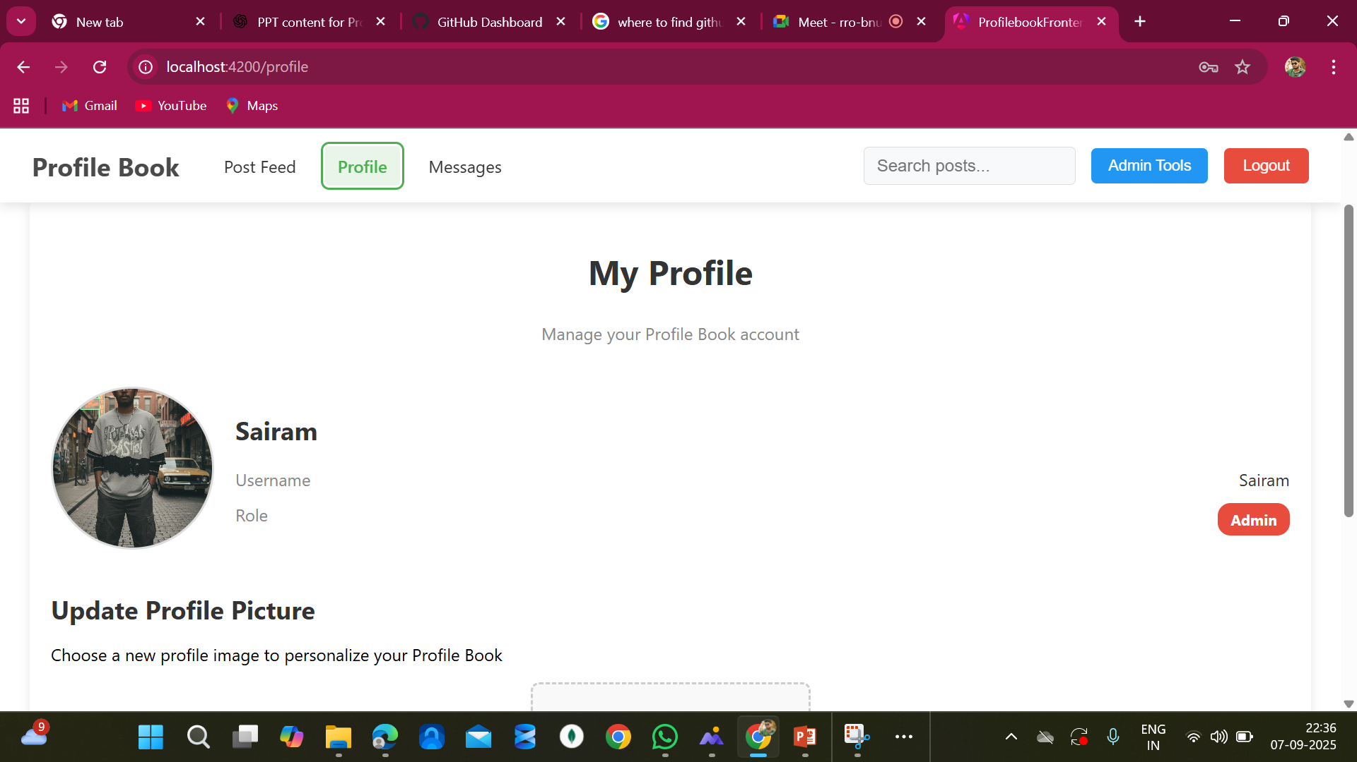
My Profile

Slide 13
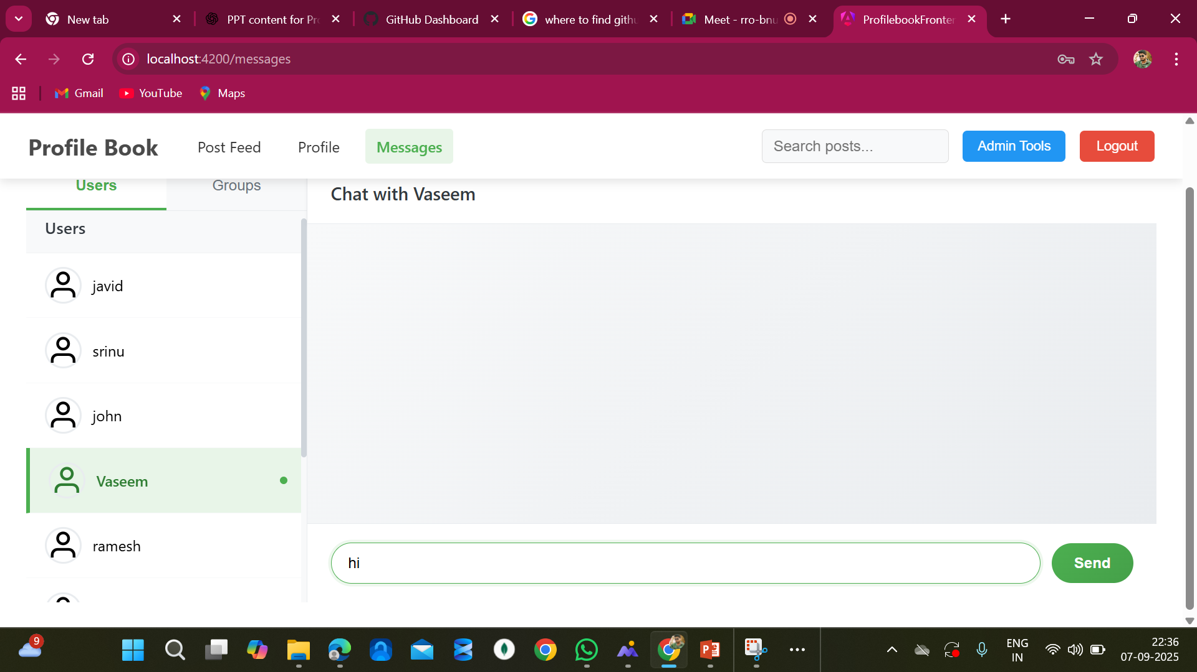
Messages

Slide 14
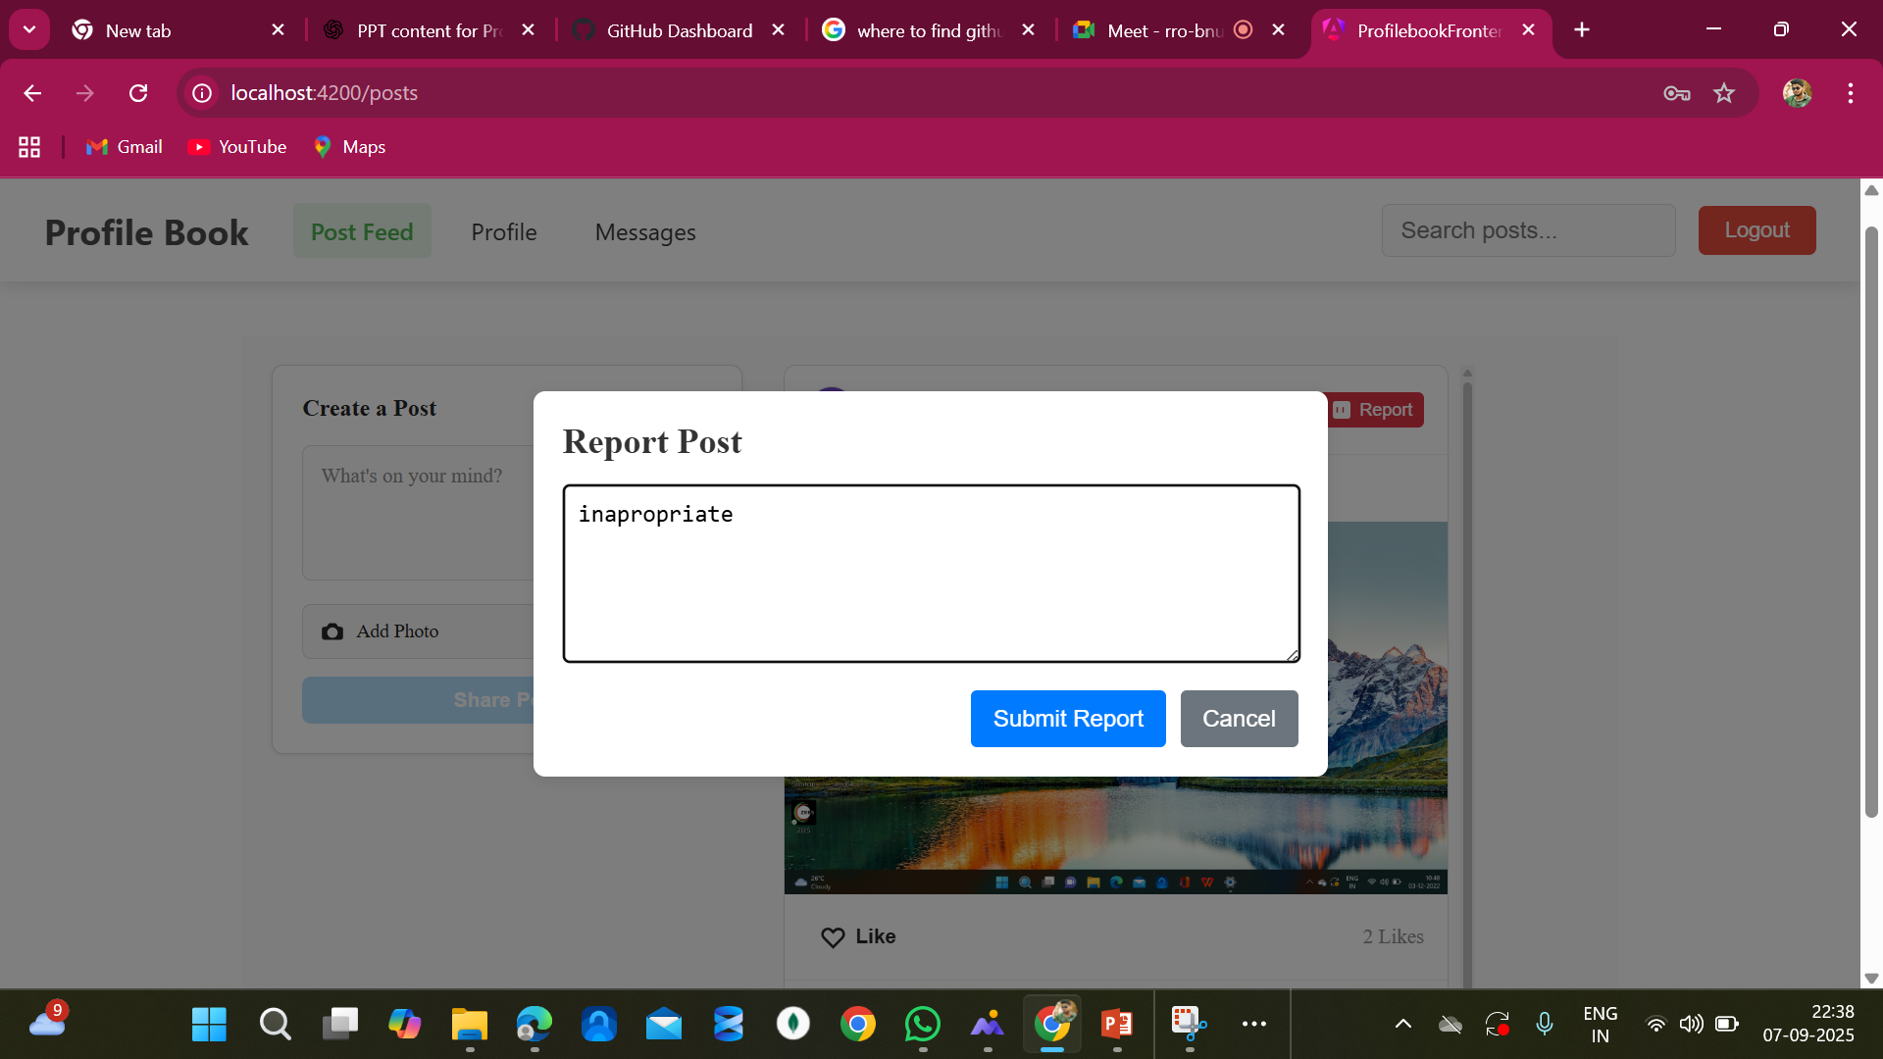
User Report

Slide 15
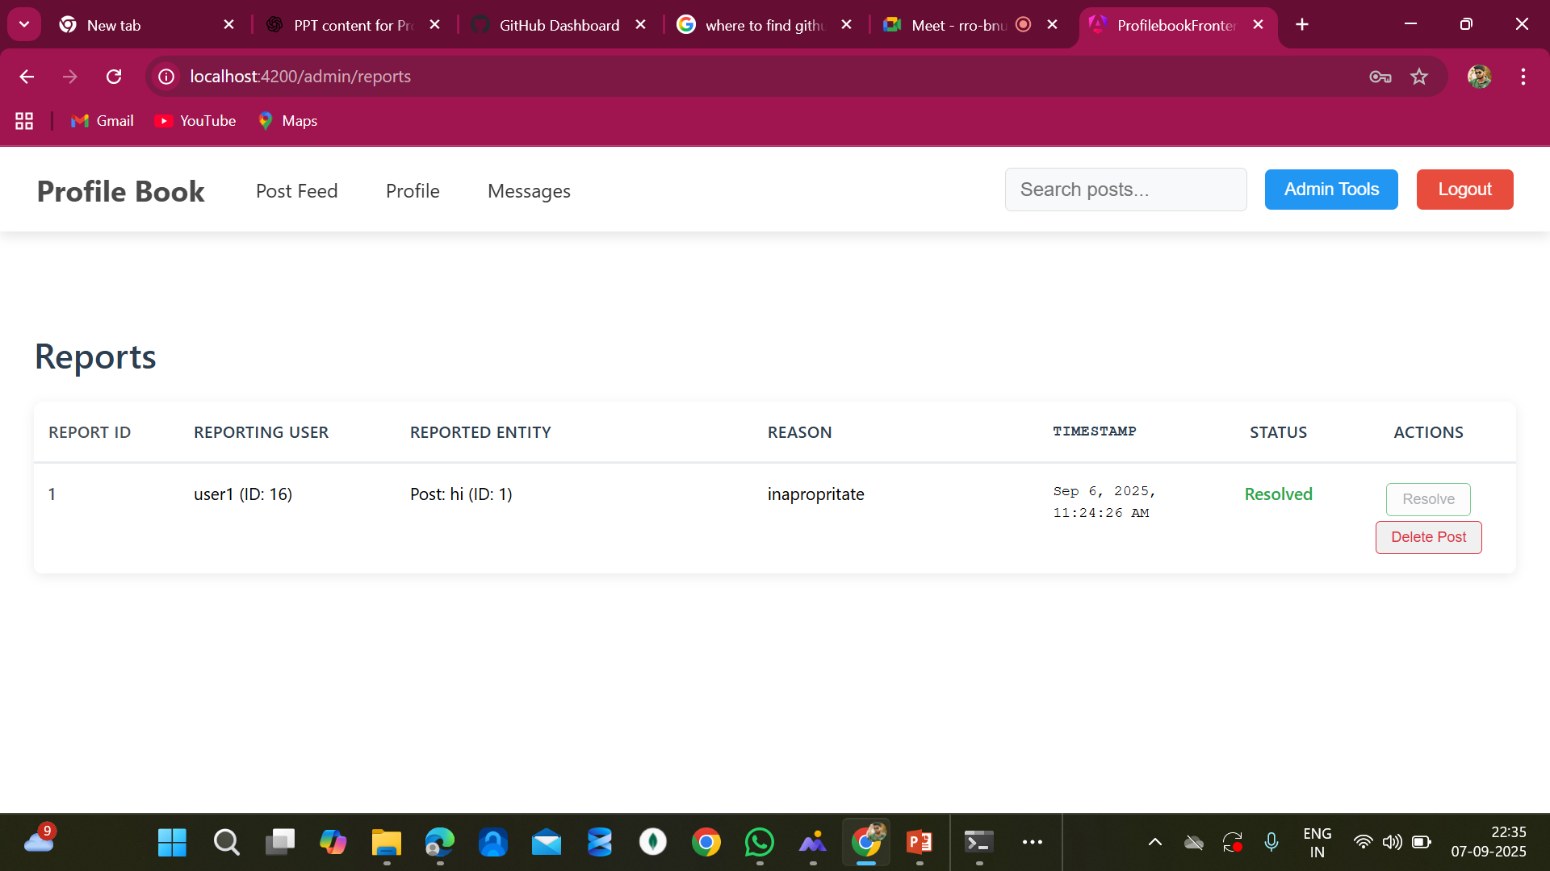
Reports dashboard

Slide 16
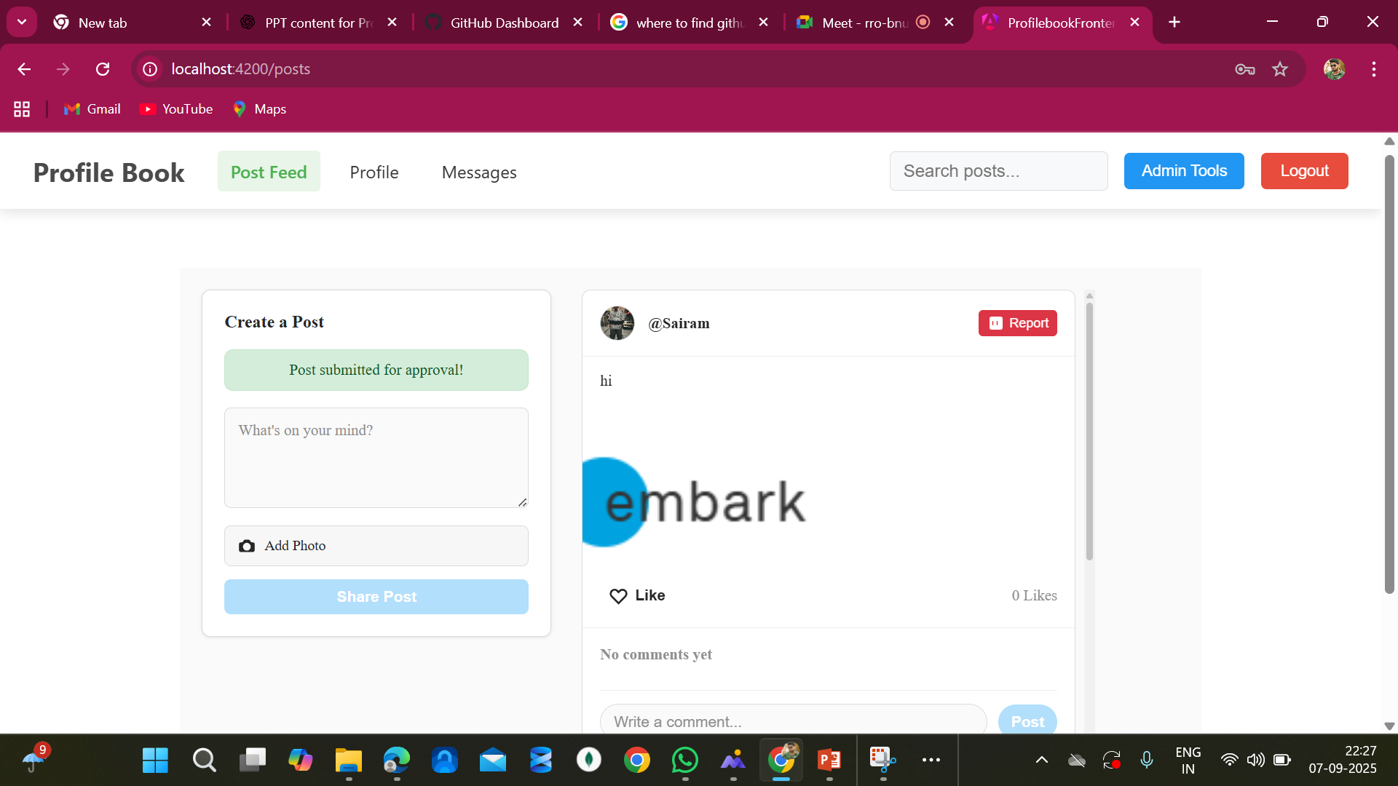
Post

Slide 17
User Feed

Slide 18

Thank You

